Slide 1

BridgeWay: Supporting Immigrant Integration
By: Alua Abenova and Jesmine Wiese

Slide 2


The Problem

Slide 3


Our Solution-BridgeWay

Slide 4
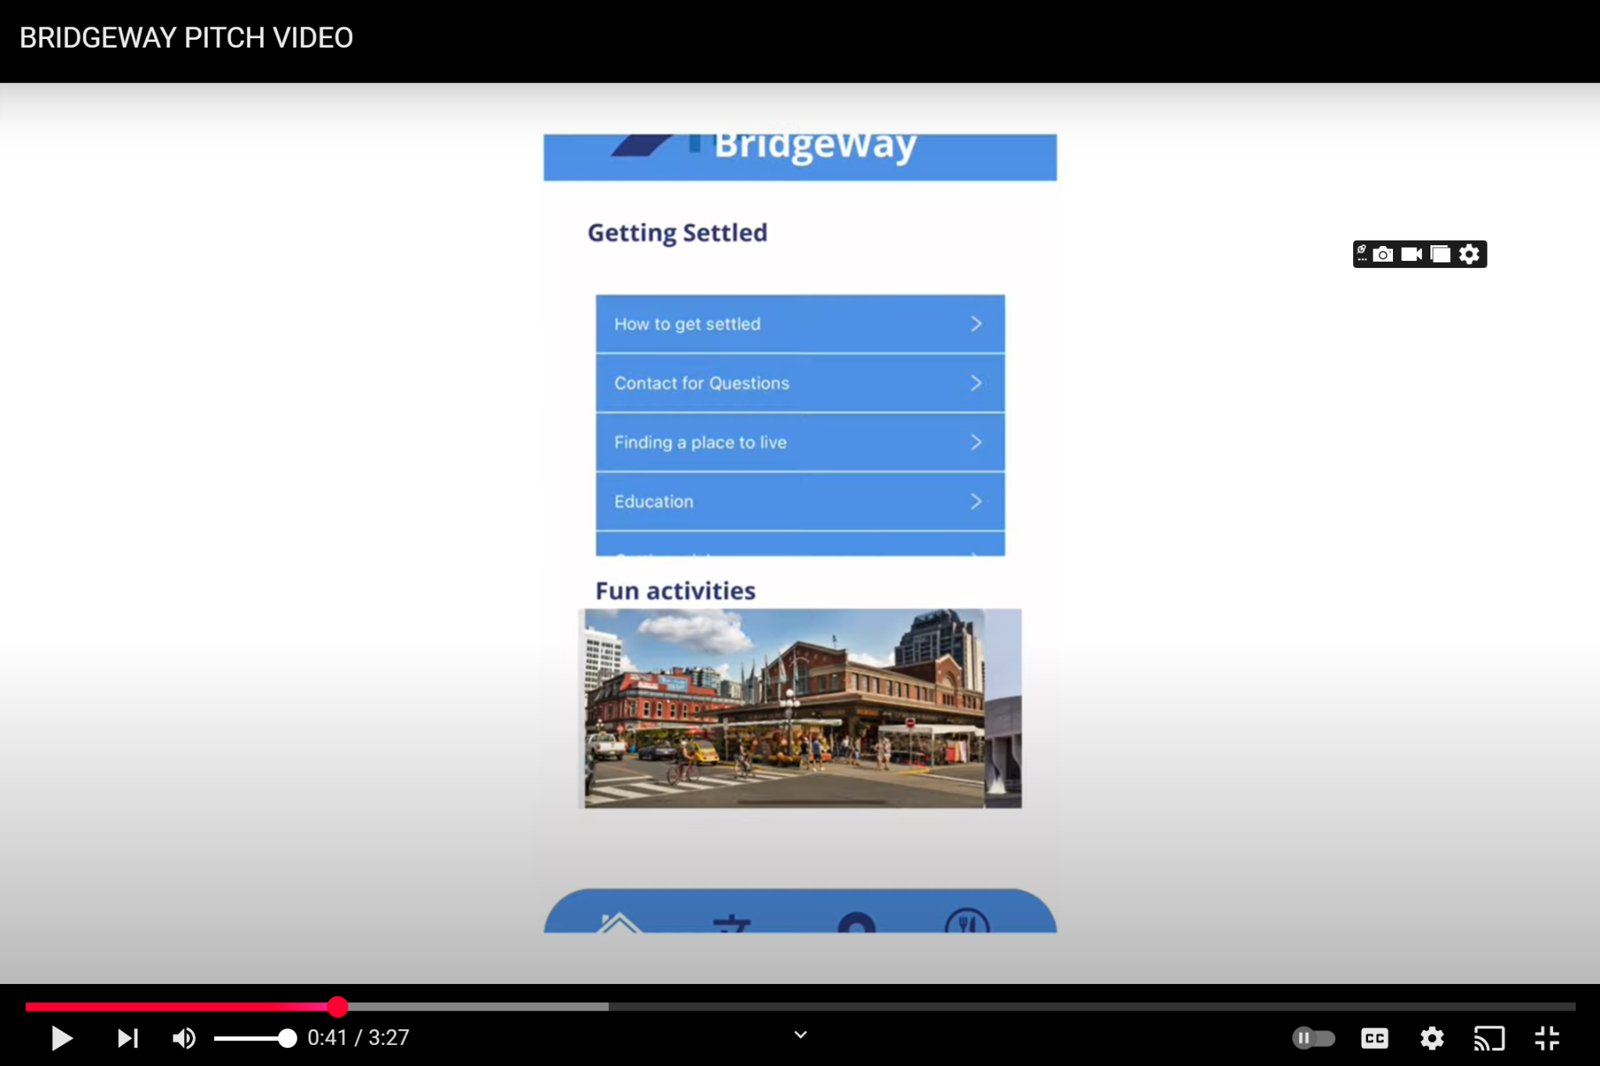
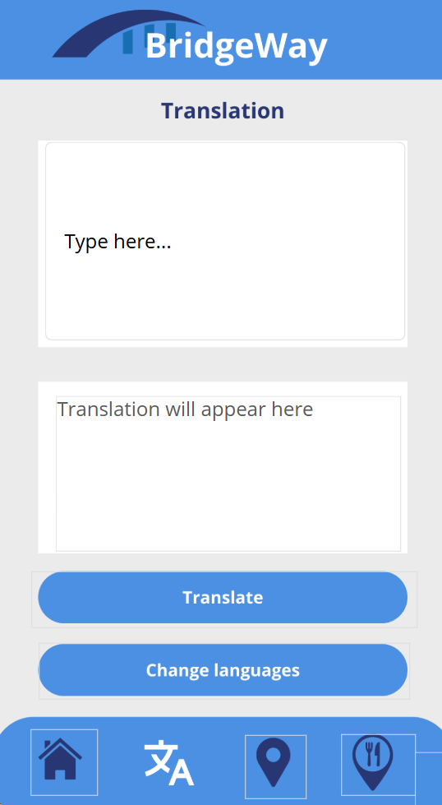
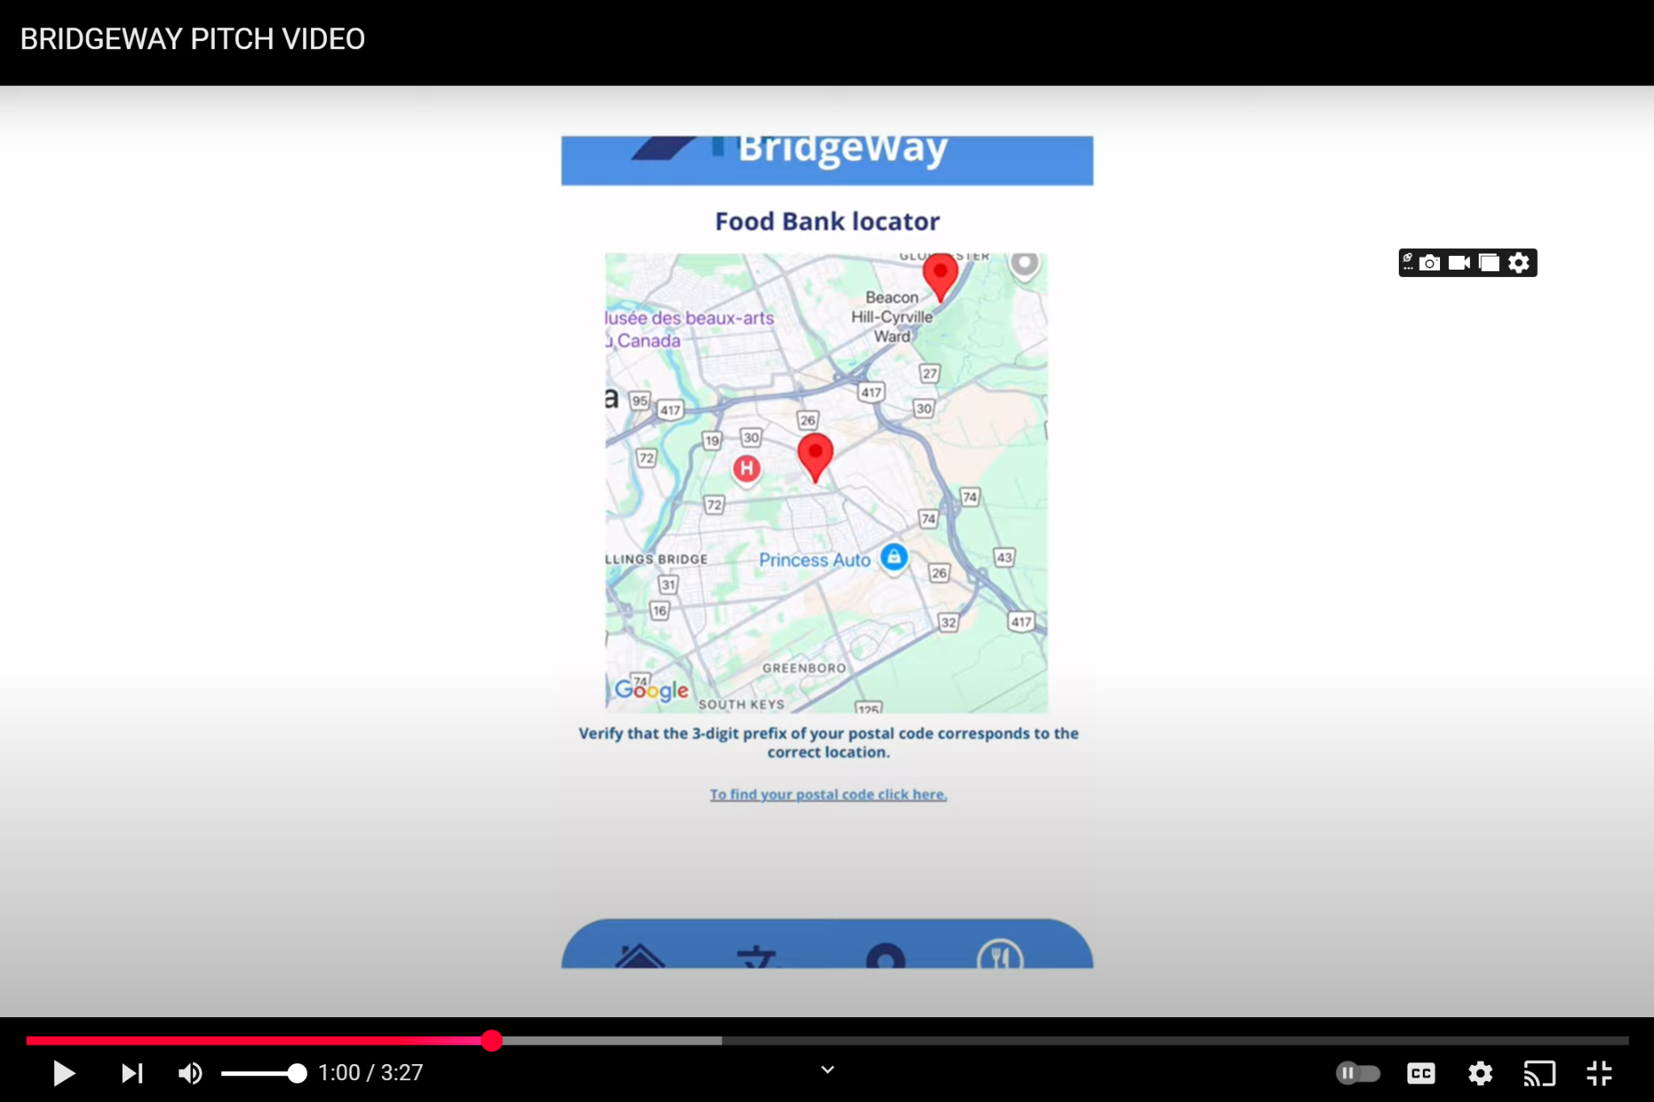
Key Features

Slide 5


UN Goal

Slide 6
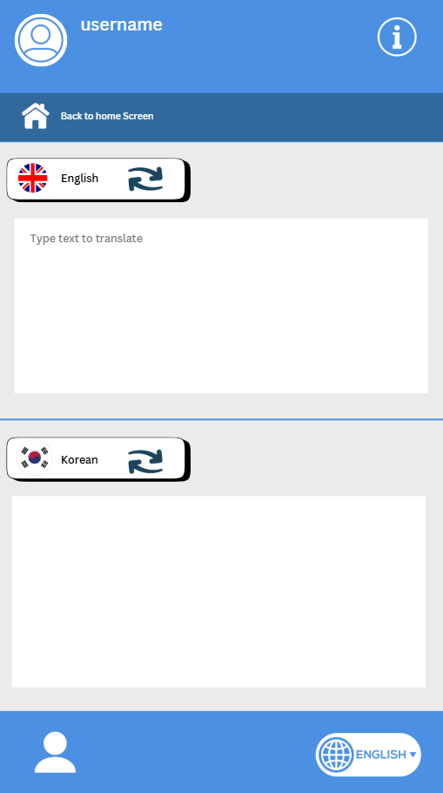
User Research

Slide 7

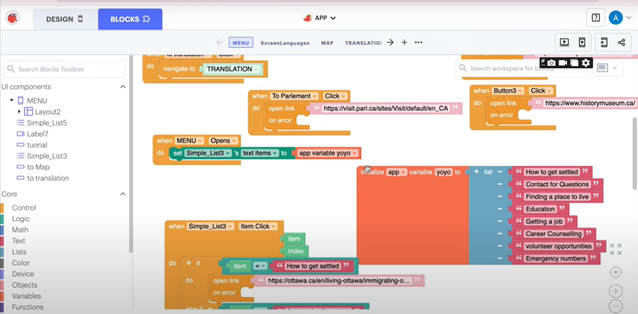
Development and Tools

Slide 8


Marketing Strategy

Slide 9


What’s Next?

Slide 10

Thank You!

